Slide 1

Internal Events and
Scheduled Tasks

Slide 2

Internal Events
What are they?
Internal event plug-ins “listen” for a specific event that is triggered and perform an action when it does (listener pattern).
EVENT
LISTENER
ACTION
Events extend/implement event interface
An Event encapsulates all the information that is needs by the listener to process

Slide 3
Internal Events
How to?
Create the event
Create the listener
Trigger the event

Slide 4
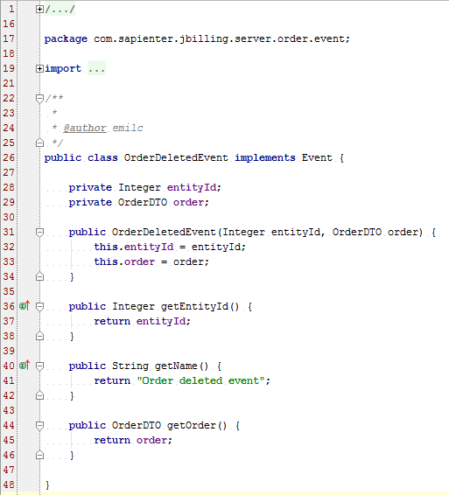
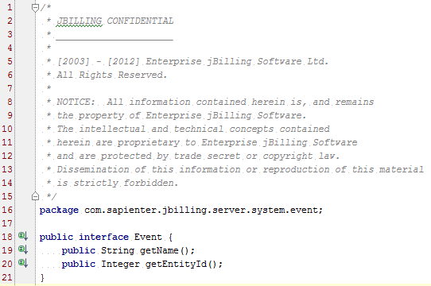
Internal Events
Create the Event

Slide 5
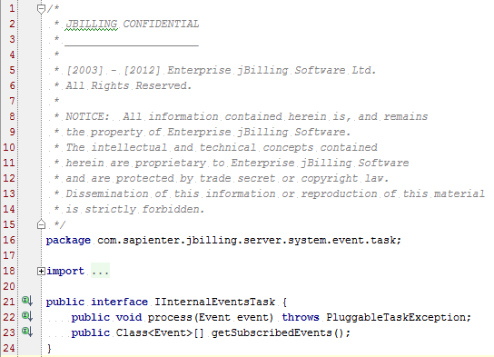
Internal Events
Create the Listener

Slide 6
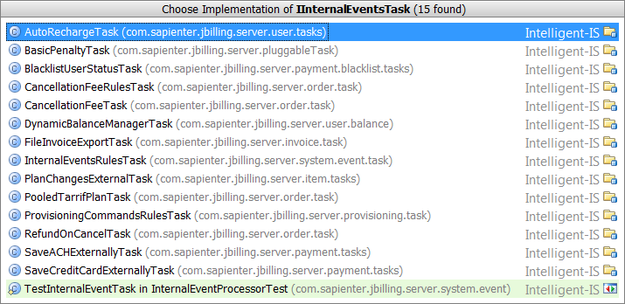
Internal Events
Create the Listener - Implementations

Slide 7
Internal Events
Create the Listener - Architecture
Event A
Event B
Listener 1
Listener 2

Slide 8
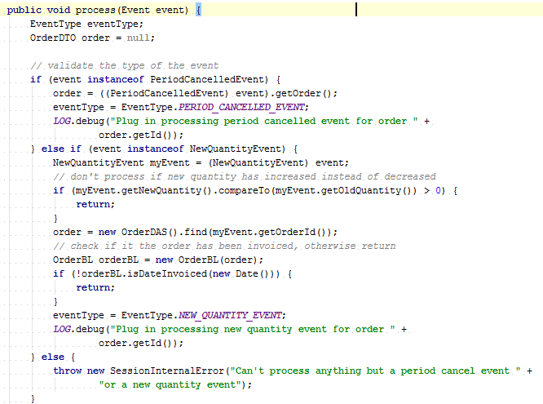
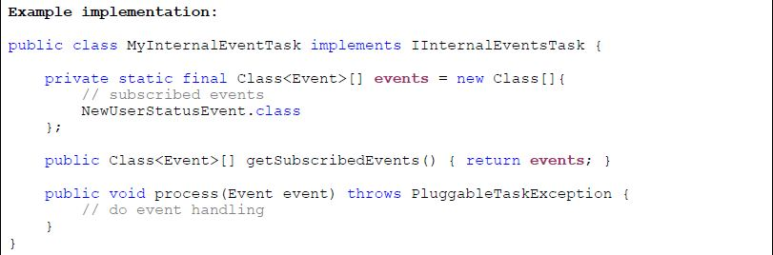
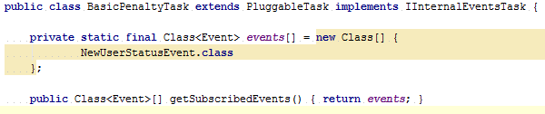
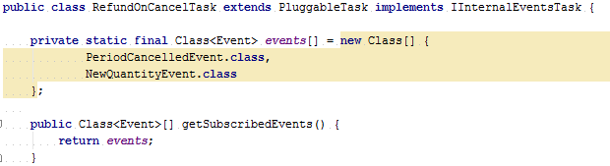
Internal Events
Create the Listener - Implementation

Slide 9
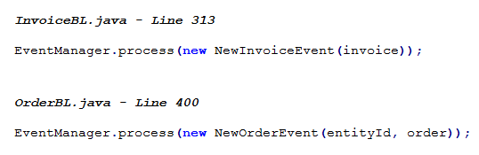
Internal Events
Trigger the Event

Slide 10
Internal Events
Questions?

Slide 11
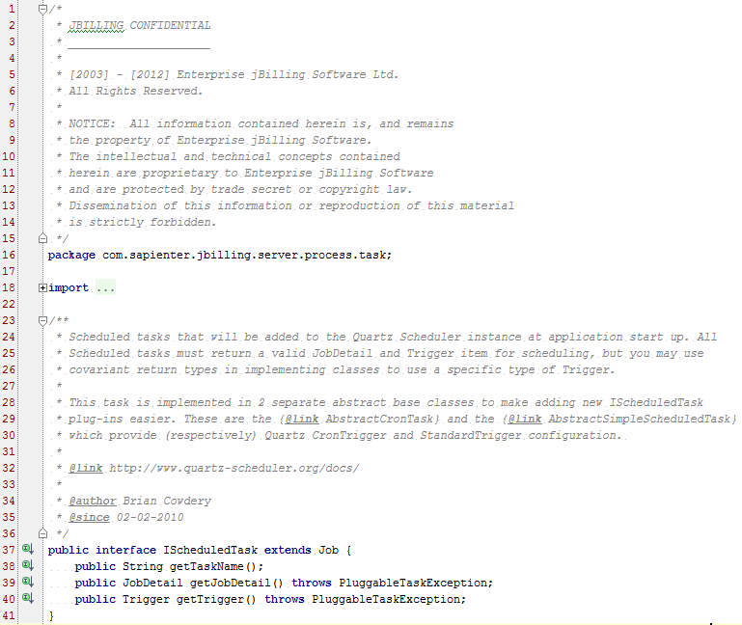
Scheduled Tasks
Pluggable tasks that can be scheduled
Schedulable using simple trigger or a cron expression

Slide 12
Scheduled Tasks
Types
Scheduled Tasks
AbstractCronTask
AbstractSimpleScheduledTasks
AgeingProcessTask
SCPUploadTask
BillingProcessTask
MediationProcessTask

Slide 13
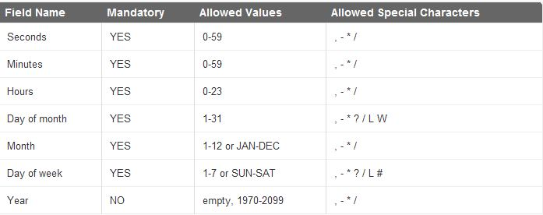
Scheduled Tasks
Types - Cron Trigger
Only one important property: cron_expression
A cron expression is a string composed of min 6 or max 7 characters separated by a white space.
Default cron expression: 0 0 12 * * ? = Fire at 12pm (noon) every day
Fields: seconds, minutes, hours, day of month, month, day of week, year (opt)

Slide 14
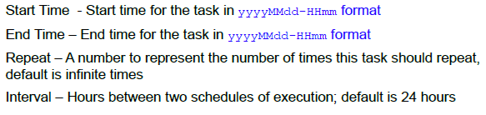
Scheduled Tasks
Types - Simple Trigger
Use a simple trigger based on start time, end time, repeat and interval
Currently only implemented as an instance of AbstractBackwardSimpleScheduledTask

Slide 15
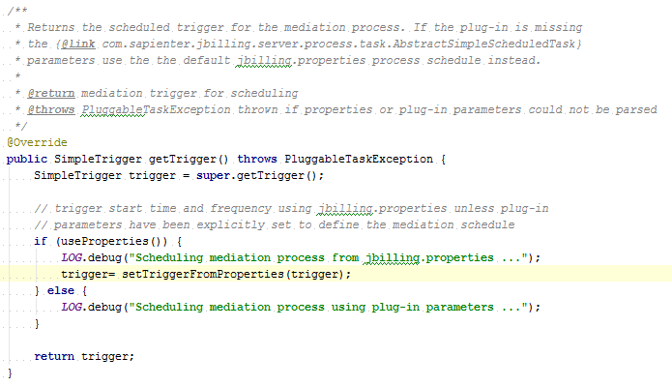
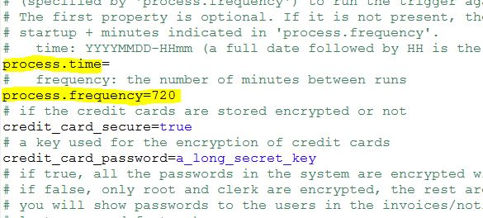
Scheduled Tasks
Types - Simple Trigger

Slide 16
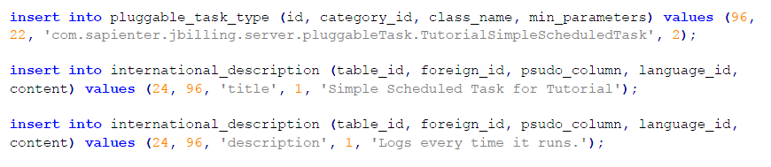
Scheduled Tasks
DB Queries

Slide 17

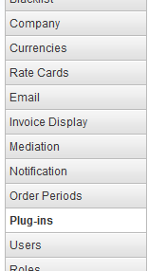
Scheduled Tasks
Configuration

Slide 18
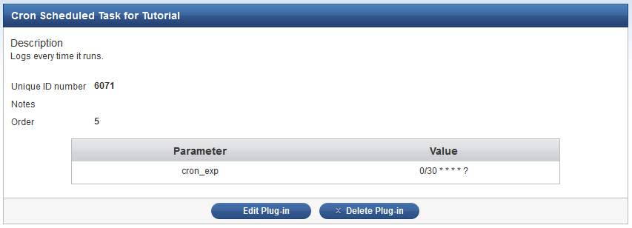
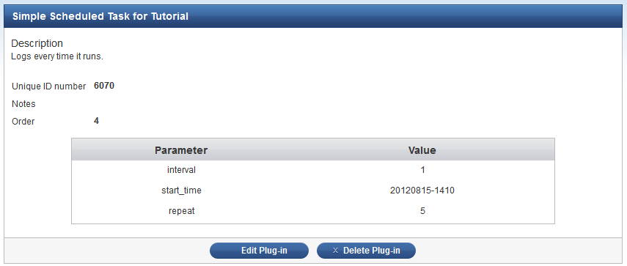
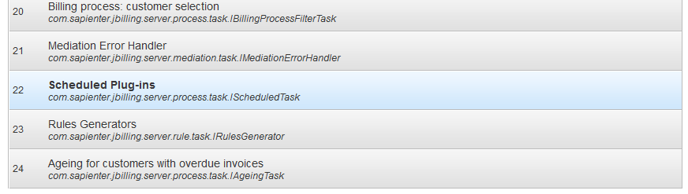
Scheduled Tasks
Configuration

Slide 19
Scheduled Tasks
Documentation
Quartz Documentation
jBilling extension guide

Slide 20
Scheduled Tasks
Questions?

Slide 21
Exercises
Internal Events
Create an event that gets triggered when a customer is updated. When the listener catches this event, create a new order for that user with the item of your choice.

Slide 22
Exercises
Scheduled Tasks
Create a scheduled task triggered by a cron expression to run every 10 seconds and log some text of your choice. Then together with the exercise files, send the log lines of the task.

